Slide 1

Annual Family Program Briefing

Slide 2

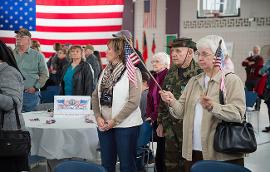
Definition of Family (CNGBI 1800.1)
For Dependency:
Spouse or children of the military member or anyone who meets military dependency criteria.
For Information (and inviting into our community):
“Family” is expanded to encompass persons who have influence over the member’s attitude toward military service, for example, parents, siblings, fiancés, fiancées, or common-law spouses.

Slide 3

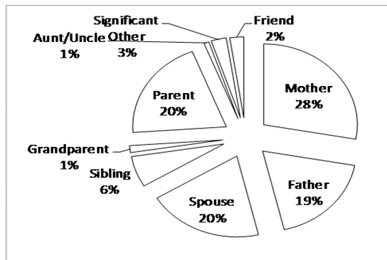

Soldier POCs
70 % Parent Figures
20 % Spouses
10 % Others

Slide 4
Service Member and Family Readiness
Individual Readiness
The state of being prepared to cope with the stressors of daily living and manage the competing demands of work life, personal life, and family life.
Family Readiness
The state of being prepared to effectively navigate the challenges of daily living experienced in the unique context of military service.
Mobility and financial readiness, mobilization and deployment readiness, and individual and family life readiness.

Slide 5

Keys to Success
Who does the Family Readiness System
require to make it successful?
TEAM effort
- Unit Family Readiness Advisors
- Service members
- ALL designated POCs
- Civilian employers
- Full-time support staff
- Commanders and 1SGs

Slide 6
Become a member
Why should YOU be a member of the unit’s Family Readiness Program?
  Gain information about the military and how it works.
  Become informed about connections to resources.
  Learn about military benefits.
  Get official news from your unit.
  Gain mutual emotional & physical support from each other (common bond).
  Make new friends.
  Have fun!!

Slide 7
Family Readiness Facts
Family Readiness cannot be achieved through “catch up” activities conducted just before or during deployment
Family Readiness is directly tied to mission readiness and retention
Family Readiness can not succeed without service and Family member involvement.
Family Strong
Guard Strong

Slide 8

Life Stressors Impact Quality of Life
Physical Health
Home/neighborhood (safety and access to resources)
Finances
Work
Spouse-partner
Children
Extended family and friends
*Moos, R. H., Fenn, C. B., and Billings, A. G. (1988)
“Stress is a biological and psychological response experienced on encountering a threat that we feel we do not have the resources to deal with.” Saul McLeod

Slide 9
J1/Service Member Support Division (SMSD)
LETS TALK RESOURCES

Slide 10














SMSD Mission – Vision
MISSION: SMSD facilitates the commander’s ability to provide comprehensive, collaborative, responsive services that support the readiness of service members, DoD civilians and families.
VISION: Commanders are able to sustain the Quality of Life for their service members’, DoD civilians’ and families’ commensurate with the purpose and calling of their service.

Slide 11

The Family Readiness System (FRS)
Composed of DoD-operated and community-based family readiness services
Delivered through a variety of access points
Enter Here
1-800-292-9464 option 3
1-800-342-9647

Slide 12

Military Family Assistance Center
Your Resource and Referral Specialists
1-800-292-9464 Option 3 - 24/7

Slide 13
Essential Service Resources
Crisis Information
Community Information
Financial Information
Legal Information
TRICARE Information
DEERS & ID Cards
1-800-292-9464 Option 3 - 24/7

Slide 14
Family Assistance Centers
Your bridge to Resources
Service Members
Government Agencies
Military
Families / POCs
DoD
Resources
FAC
Veterans
Community Based Services
Veteran
Families
Veteran Service
Organization
Programs
1-800-292-9464 Option 3 - 24/7

Slide 15


Slide 16

What Do We Do?
Military Youth Summits
Youth Camps
Deployment Cycle Support and Programming
Resource and Referral to Military Families
Support to Schools
Support to Community Agencies

Slide 17

Military Life-Cycle Support
Career
New to military
Single
Family
Employment
Education
Retirement
Deployment
Benefits
Disabilities
Married
  Transition Assistance Advisor (TAA)
  1st Line of Support for Returning Veterans
  Benefits, Education Assistance, Employment and Transition Issues
  Employer Support of the Guard & Reserve (ESGR)
  Education and Awareness Regarding Employer Relations and USERRA
  Interaction with many Employers

Slide 18

Citizen Soldier for Life (CSFL) Program Overview
www.csfl.online
Notes:
The Citizen Soldier for Life program vision is to prepare and connect Service Members and their Families within the 54 States, Territories and District of Columbia with financial and career readiness education to prepare for opportunities for betterment – whether it be a more sound budget or employment. When the Soldier and Family are in a good position in terms of financial stability and employment, they are more resilient, ready and capable of accomplishing the State and Federal mission.

Slide 19
CSFL: MISSION
The mission of the Citizen Soldier for Life program is to maintain a ready and resilient force capable of accomplishing State and Federal missions by connecting ARNG Soldiers, Dependents, Veterans and Retirees with financial and career education plus employment opportunities throughout the Soldier Life Cycle.
www.csfl.online

Slide 20
CSFL: GOAL
The goal of the Citizen Soldier for Life program is to boost the resiliency of the ARNG force by enhancing military and civilian career opportunities and developing financially literate, transition ready, and employable Soldiers.
www.csfl.online

Slide 21
Career Readiness Standards
Career Readiness Standards prepare Soldiers and families with the knowledge, tools, and skills needed to achieve their individual career goals.
Basic Resume Development
Help registering on VA eBenefits (www.ebenefits.va.gov)
Prepare a 12-month budget spend plan
Financial Literacy Training: Blended Retirement System
Financial Literacy Training: Initial Entry Training
www.csfl.online
Notes:
As a new Soldier, you should know your CRS touchpoints, understand when, by regulation, you are required to touch base with your CRC and receive the proper training.
Within the first 6 months of arrival at your parent unit, you will complete any requirements not completed while in RSP – that includes an IDP.
Each year, you will be required to reach out to your CRC for your Annual Review. The annual review is an update of your IDP and an update to your 12 month budget/spend plan. These items are also updated any time you receive a promotion, you PCS, or have a major life event such as a marriage, divorce, birth of a baby – anything that might change your living expenses.
If you become unemployed – or realize you are not making a living wage with only one job – you would reach out to your CRC.
If you change your career projectory – you would reach out to your CRC.
If you reenlist – you would see your CRC for a MOS crosswalk/GAP Analysis and an occupational interest self assessment.
If you become aware that you will mobilize, it is recommended you reach out to your CRC.
If you decide to leave the ARNG – you would also reach back to your CRC to ensure your readiness for separation/transition.

Slide 22
Who Does CSFL Service?
Career Readiness Counselors provide financial literacy training, career
readiness, employment assistance and outreach to all ARNG Soldiers, their
immediate Family members, Retirees, Veterans and other Service Members
from DoD Components:
During the initial phase of service
Pre-mobilization at Home Station and in coordination with the Transition Assistance Advisors at the demobilization site
At key transition points during a Soldier’s Life Cycle
At service transition
When requested at unit drills
Individuals walk-ins and appointments
www.csfl.online
Notes:
Your CRC provides services to every Soldier of the ARNG as a priority. If for any reason, they are unable to provide you a service (time constraints, etc), you will be referred to a local specialist to assist.

Slide 23


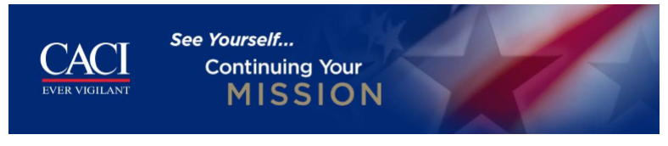





Employer Partnerships
www.csfl.online
Notes:
When we’re not here talking to units on the weekends, and we don’t have a visitor in the office for specific services, we are out building partnerships with local employers to make your finding a living wage job much easier – especially being a National Guardsmen. Here are a few of our partnerships we have.

Slide 24











Community Partnerships
www.csfl.online
Notes:
If we aren’t out on the streets talking to local employers, we’re talking to our community partners that are also resources for us to help you meet your career readiness, education and employment goals.

Slide 25


For more information, or to register for assistance,
Please contact the following staff members:
Sergeant Casey Kautzmann
Employment Assistance Coordinator
cassandra.m.kautzmann.mil@mail.mil
608-242-3466
Greg Peltier, Contractor
Career Readiness Counselor
greg.a.peltier.ctr@mail.mil
608-242-3412
https://www.facebook.com/ARNGCSFL
https://www.twitter/Citizen Soldier4Life
www.csfl.online

Slide 26


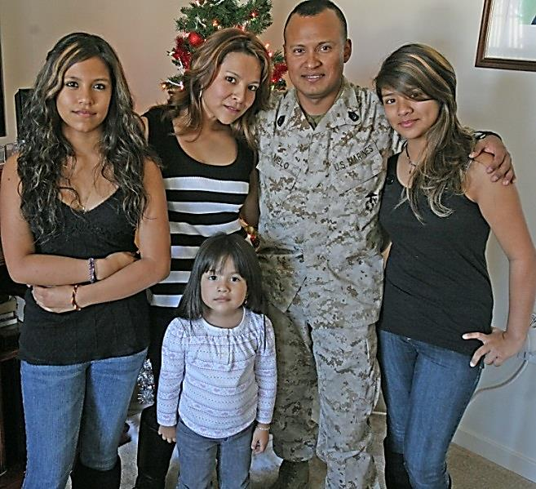
MFLC Personal Financial Counselor (PFC) Services Overview

Slide 27

MFLC Personal Financial Counselor (PFC) Services Overview
We can help with:
Spending plans
Thrift Savings Plan
Debt repayment
Deployment, transition, and retirement preparation
Tax planning

Slide 28

PFC Services
Consumer Advocacy
Consumer Advocacy Services
Identity theft
Pay-day loans
Consumer safety and rights
Filling out forms
Contacting and working with creditors
Referrals

Slide 29

Strong Bonds
Strong Bonds is a chaplain-led program which assists commanders in building individual resiliency by strengthening the Army Family.
Family Workshops
  The 7 Habits of Highly Effective Military Families
  Family Wellness
  Active Relationships
Individual Workshops
  P.I.C.K. Premarital Interpersonal Choices & Knowledge
  Got Your Back
Married Workshops
  Couples Communication I & II
  Active Relationships
  Fearless Marriage
Single & Married Workshops
  The Five Love Languages
Notes:
Strong Bonds is a chaplain-led program which assists commanders in building individual resiliency by strengthening the Army and Air Force Family. The core mission of the Strong Bonds program is to increase individual Soldier, Airmen and Family members’ readiness through relationship education and skills training.

Slide 30
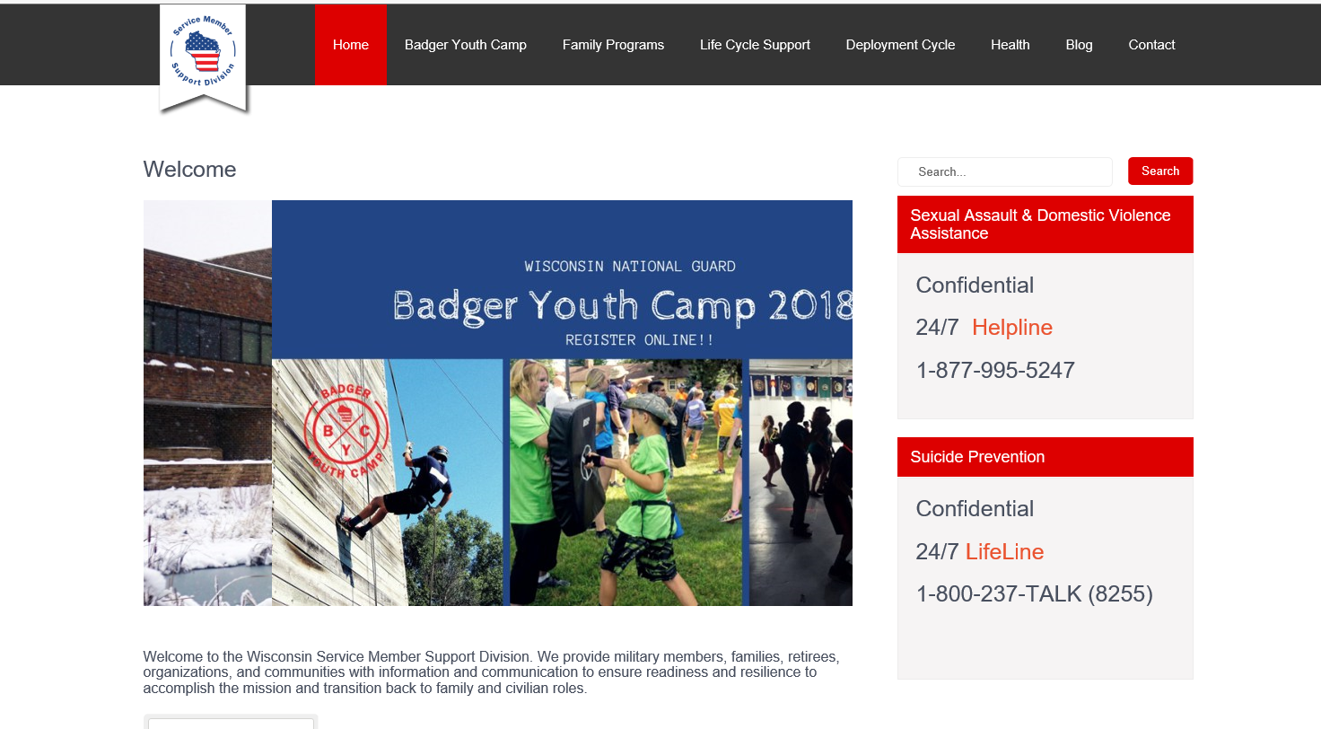
SMSD WEBSITE www.wisconsinmilitary.org

Slide 31


Military OneSource
Connecting You
to Your Best MilLife
Notes:
If you haven’t explored Military OneSource, now’s the time to discover this world of assistance all in one place and at your fingertips.

Slide 32

Connecting You to Your Best MilLife
Military OneSource:
Your 24/7 connection to information, answers and support.
Your one source for your best MilLife.
Dedicated to the greater military community — service members, military spouses and families
Helping you take full advantage of all the benefits and resources you have available
Operated under the direction of the Deputy Assistant Secretary of
Defense for Military Community and Family Policy
Notes:
So what is Military OneSource? Many things to many people.
Military OneSource is your one source, available 24/7, providing information, resources and assistance for your best MilLife.
A community with a deep understanding of Military Life – powered by people with extensive training and experience in military culture.
It’s all about helping our entire community — service members and military families — take advantage of all the resources and services you have available, for the most positive and fulfilling military experience.

Slide 33


More Ways We Serve You
A single source of information and assistance for service members and military families
Private, discreet, individualized support
Free, tailored, confidential
Trustworthy information and resources
— from the Department of Defense
Notes:
More ways we serve and support the military community:
A single source of information and assistance for service members and military families alike – because families are critical to readiness.
We offer private, discreet, individualized support through counseling and consultations.
Our services are no cost and tailored to the situation
Our information and resources are trustworthy, because they come from the Department of Defense

Slide 34

Serving Our Military Community Worldwide
Here’s who is eligible for
Military OneSource services:
All active duty, National Guard and Reserve Component service members, regardless of
activation status
Immediate family members
Coast Guard, when activated with the Navy
Expeditionary civilians, 90 days pre- until 180 days post-deployment
Retired or discharged honorably to include a
general discharge, up to 180 days past separation
Survivors: non-remarried spouses and children
Notes:
Military OneSource serves our total force.
Here’s who is eligible for Military OneSource services:
All active duty, National Guard and Reserve Component service members, regardless of activation status
Immediate family members
Coast Guard, when activated with the Navy
Expeditionary civilians, 90 days pre- until 180 days post-deployment
Retired or discharged honorably to include a general discharge, up to 180 days past separation
Survivors: non-remarried spouses and children
Eligibility begins when the service member enters the military and for the most part, ends six months after transitioning out.
Extended program eligibility reaches anyone who is enrolled in the Defense Enrollment Eligibility Reporting System— more commonly known as DEERS.
There are more details about eligibility at the Military OneSource website.

Slide 35
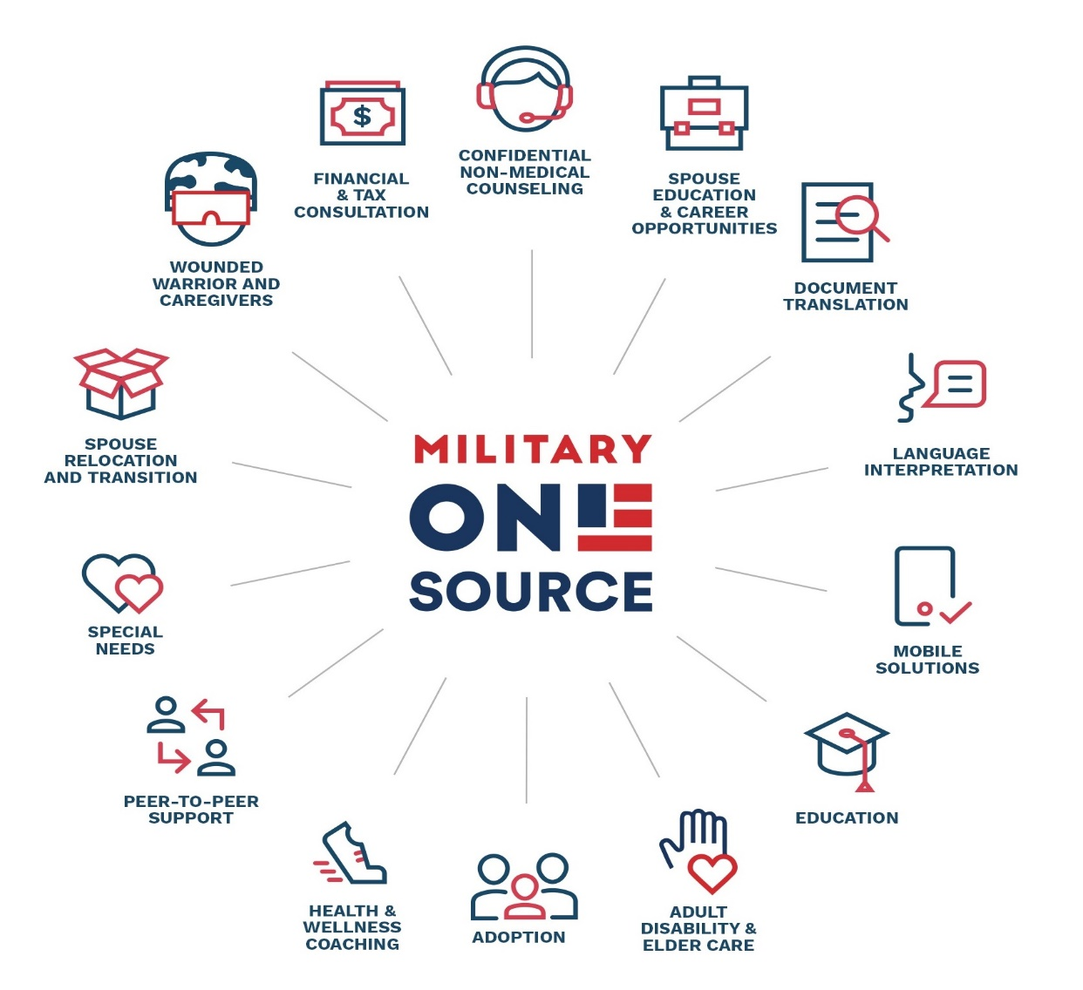
Connecting You to Support and Resources
Notes:
• Military OneSource offers a wide range of individualized consultations, coaching and counseling for many aspects of Military Life.
• [READ SLIDE OR POINT OUT HIGHLIGHTS]
• Everything from Financial Counseling to Education to Non-medical Counseling.
• It’s all to help our military community and families live resilient and ready
• And connect you to the resources you need to thrive.

Slide 36


Privacy Protections
Personal information is secure. Each user is treated confidentially
and with respect, regardless of rank
Privacy protections ensure your personal information will not be:
  Provided to the military or chain of command
  Shared with family or friends
  Released to other agencies
Privacy exceptions include the following duty-to-warn situations:
  Suspected family maltreatment (domestic violence,
  child or elder abuse or neglect)
  Harm to self or others
  Illegal activity
Notes:
Contacts with Military OneSource are private.
Privacy protections ensure your personal information will not be:
Provided to the military or chain of command
Shared with family or friends
Released to other agencies
• This means that a family member may seek non-medical counseling without the knowledge or consent of the service member.
• Or a service member may seek non-medical counseling without the knowledge of command.
There are some exceptions. Military OneSource consultants — including non-medical counselors — have a duty to report some situations to appropriate military and civilian authorities.
Privacy exceptions include the following duty-to-warn situations:
Suspected family maltreatment (domestic violence,
child or elder abuse or neglect)
Harm to self or others
Illegal activity
If you have questions regarding a situation, a Military OneSource consultant can provide detail.

Slide 37




Connect to Your Best MilLife
You Can Expect:
Worldwide access 24/7/365
Free and confidential support
Objective and experienced experts
Current and practical information and tools
A commitment to help service members and military families thrive
Toll-free telephone
800-342-9647
www.MilitaryOneSource.mil
with live chat
www.MilitaryOneSource.mil
Interaction with
trained professionals
Notes:
That’s a quick tour through the very large universe of Military OneSource and all that’s waiting for you. Turn to us anytime. You can rely on us for:
Worldwide access 24/7/365
Free and confidential support
Objective and experienced experts
Current and practical information and tools
A commitment to help service members and military families thrive

Slide 38
Questions?
Your 24/7 connection to information, answers and support.
Your one source for your best MilLife.
800-342-9647 • www.MilitaryOneSource.mil
Notes:
Does anyone have any questions?
[Let them know how long you will be around after the presentation and where they can find you if they think of a question they would like to ask later on.]
Direct additional questions to the Military OneSource call center at 800-342-9647.
[Point out the contact phone number and website to audience members and remind them to direct additional questions and concerns to a Military OneSource consultant through the call center.]

Slide 39
OPSEC and Safe Social Networking

Slide 40
What is OPSEC?
Simply, a process designed to protect sensitive unclassified information
And a way to keep our sensitive/critical information out of the hands of the “bad guys”

Slide 41

The OPSEC 2-step
What do you need
to protect?
How do you need to protect it?

Slide 42
Critical Information List
Ammunition and Security
Security measures to protect equipment, people, and high dollar items
Unit Information
Drill Schedules, deployment, and shortfalls in equipment and manning
Readiness Levels and future operations
People
Casualty Notifications
Location of VIPs
Quantities, types, and location guns and ammunition
Vulnerabilities of military members

Slide 43


How do we protect it?
Safeguard critical information
  Be vigilant
  Only share information on need to know basis
  Safe social media

Slide 44


Daily social media interactions
Be cautious when accepting friend requests Don’t share information that you don’t want to become public.
Be cautious when listing your job, military organization, education and contact information.
Providing too much information in your profile can leave you exposed
Pvt. Creeper

Slide 45
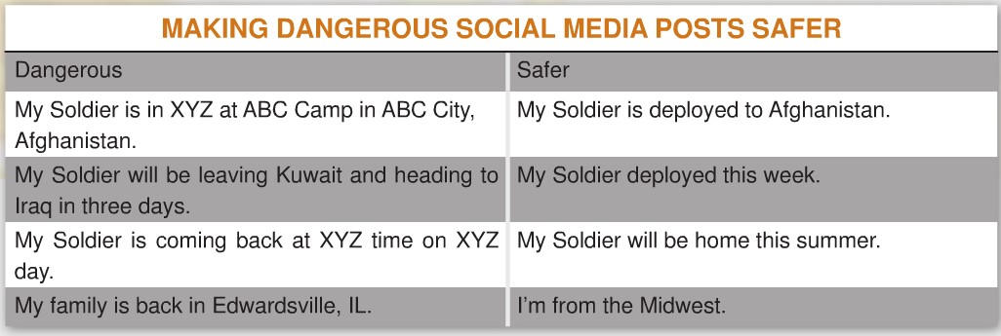
What not to post
Do not post personally identifiable information
If you aren’t comfortable placing the same information on a sign in your front yard, don’t put it online.

Slide 46
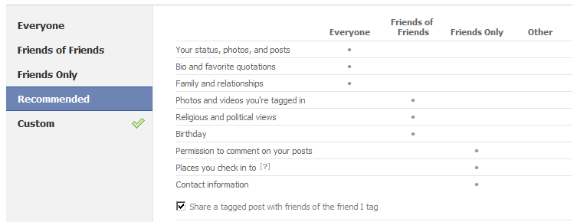
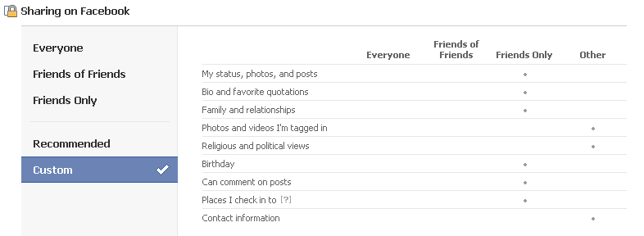

Privacy Settings
Facebook’s default privacy settings are often public, but Facebook provides various setting options that help users adjust privacy settings.
Twitter allows users to keep their Tweets private
Flickr gives users the option of keeping photos private.
Similar privacy settings can be found on other social media sites

Slide 47
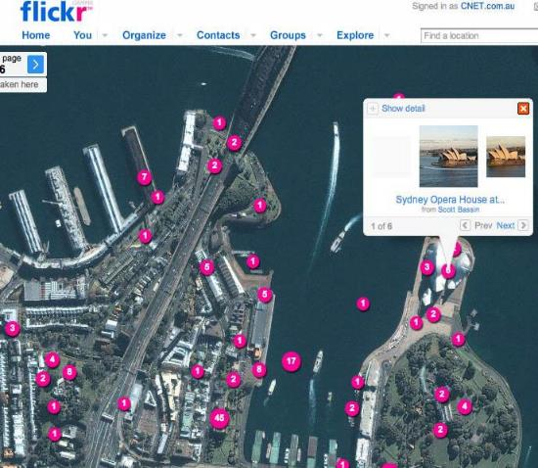
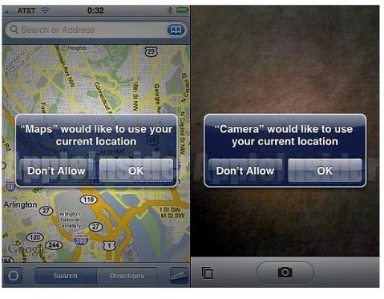

Geotagging Safety
Is the process of adding geographical identification to photographs, video, websites and SMS messages
Equivalent of adding a 10-digit grid coordinate to everything you post.
Geotags are automatically embedded in some pictures taken with smartphones.

Slide 48

Questions

